Slide 1
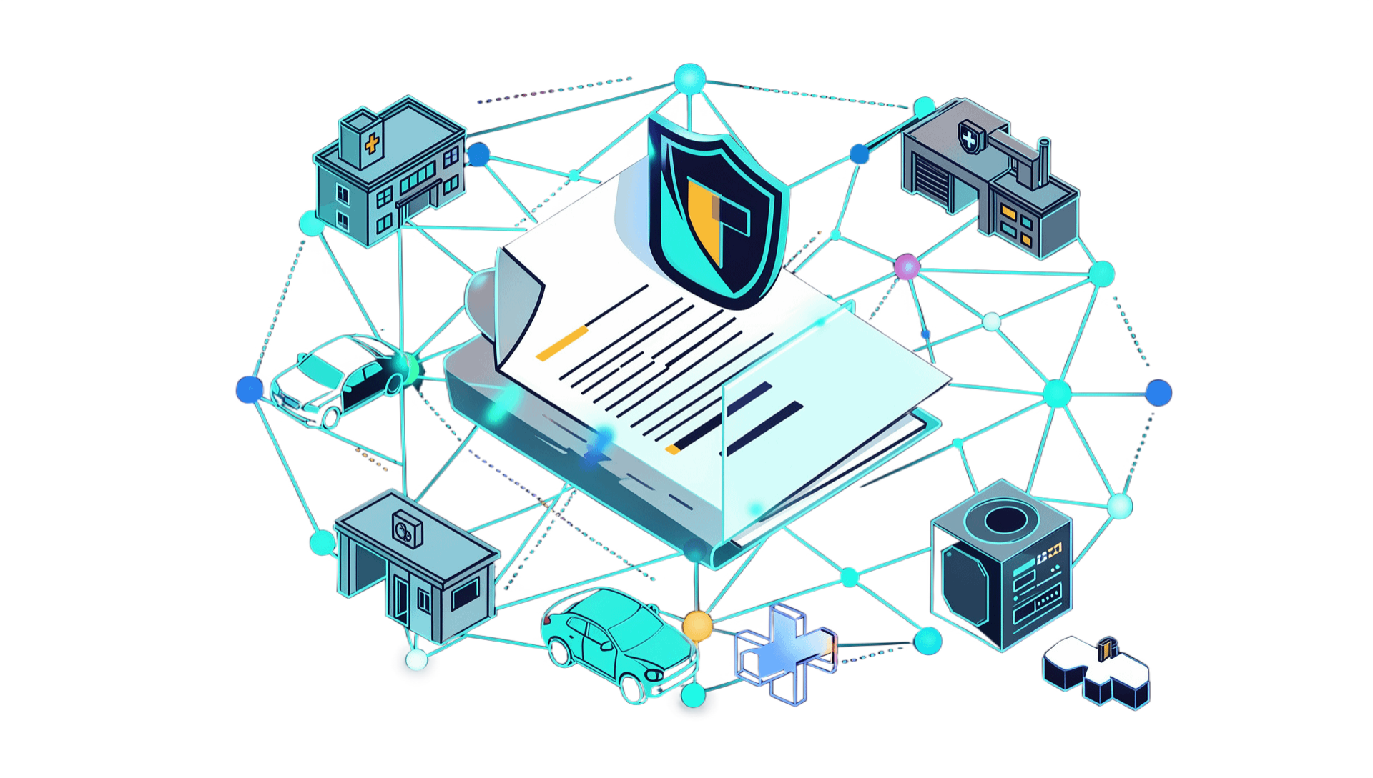
HYPERLEDGER IN INSURANCE
HOW PERMISSIONED BLOCKCHAIN IMPROVES CLAIMS PROCESSING
A single claim crosses hospitals, surveyors, insurers, and reinsurers. The core problem is getting every party to agree on identical facts without relying on one company's central database.
MSc Blockchain Technology
Roshani Kamble
Sakshi Raut

Slide 2
/workflow/claim-lifecycle
ONE CLAIM — MANY ORGANIZATIONS
Five independent entities must collaborate to resolve a single incident.
01
02
03
04
05
CUSTOMER
HOSPITAL
SURVEYOR
INSURER
REINSURER
Files the initial notice of loss and submits incident photos.
Treats the patient and generates itemized medical bills.
Inspects physical damage and verifies treatment authenticity.
Checks policy limits, deductibles, and issues payout approval.
Audits high-value claims to settle shared catastrophe liability.
01 DOCUMENTS | 02 VERIFICATION | 03 APPROVAL | 04 PAYMENT | 05 AUDIT
Bills and police logs | Coverage checks | Multi-party sign-off | Bank disbursement | Regulatory reporting
Core friction: Each organization maintains its own separate siloed IT system.
02

Slide 3
/analysis/root-cause
WHY IS THE PROCESS SLOW?
Separate records
Hospital, insurer, TPA and surveyor keep separate records.
Manual checking
Documents move through email, PDF, CSV and manual checking.
Mismatches
Records may not match.
Repeat checks
The same claim may be checked many times.
Harder oversight
Auditing and fraud detection become harder.
03

Slide 4
/architecture/transition
FROM MANY DATABASES TO ONE TRUSTED NETWORK
Replacing point-to-point synchronization with a shared immutable ledger.
BEFORE · SILOED MODEL
AFTER · FABRIC PERMISSIONED NETWORK
Fragmented and vulnerable
Unified and cryptographically verified
Each party owns a proprietary database
Information moves through insecure point-to-point email and APIs
Reconciliation occurs after discrepancies appear
No single shared source of operational truth
Vetted consortium members operate authorized peer nodes
Parties share verifiable claim transaction state in real time
No single organization owns or controls the shared ledger
Transactions record verified state changes, keeping raw files off-chain
Consensus model: Every authorized peer maintains an identical, cryptographically appended copy of the claim transaction history.
04

Slide 5
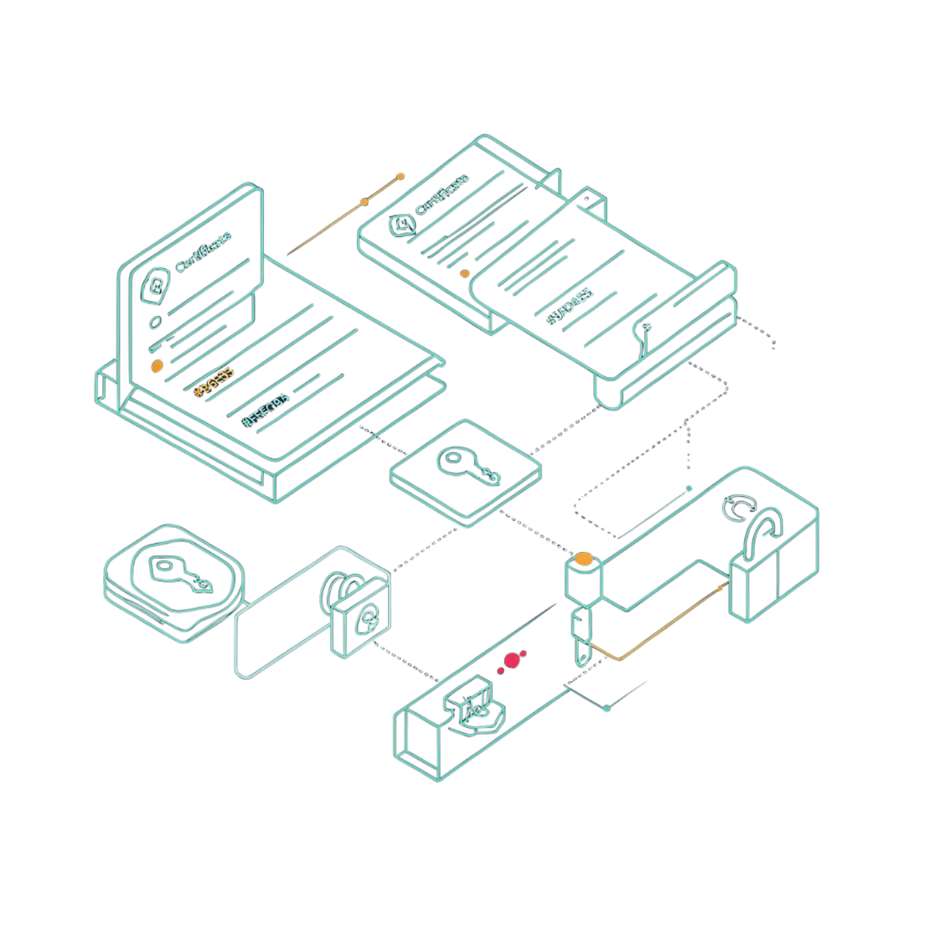
/framework/hyperledger-fabric
WHY FABRIC FOR INSURANCE?
IDENTITY | Only approved organizations can join.
CHAINCODE | Code containing insurance rules.
ENDORSEMENT | Required organizations approve a transaction.
PRIVATE DATA | Sensitive information goes only to selected members.
LEDGER | Stores transaction history.
WORLD STATE | Stores the current claim status.
protocol: enterprise modular DLT
Permissioned · Private · Auditable · Automated
05

Slide 6
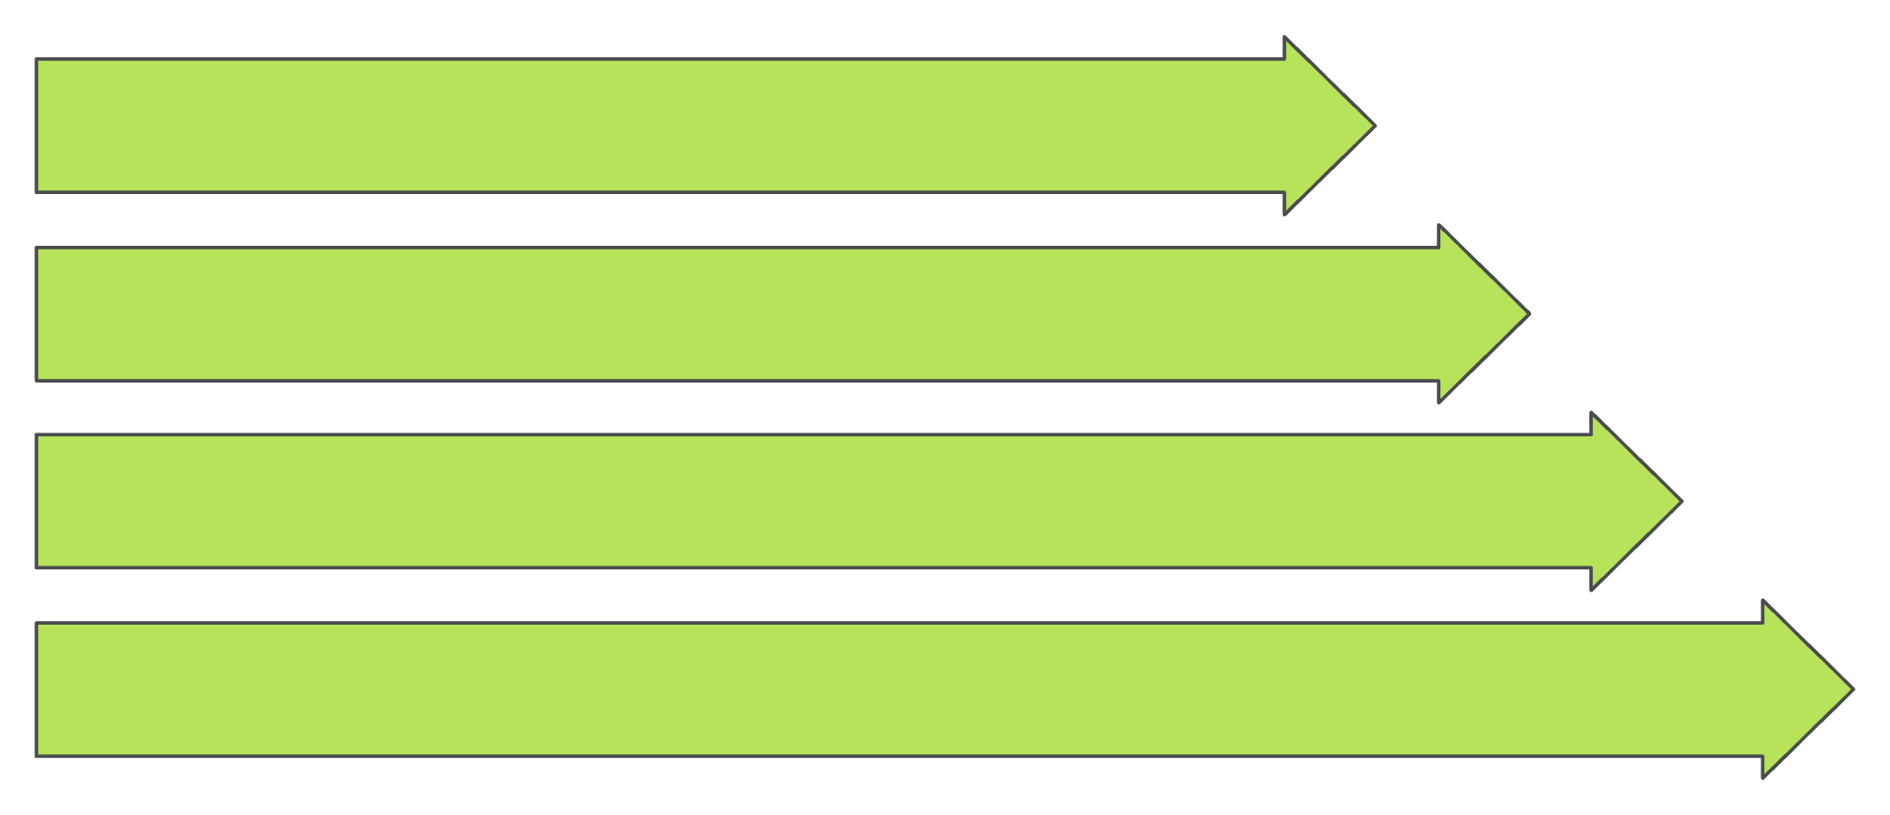
/architecture/core-components
HOW DOES FABRIC WORK?
USER OR INSURANCE APPLICATION
FABRIC GATEWAY → PEERS
CHAINCODE → ENDORSEMENT → ORDERING SERVICE
BLOCK → VALIDATION → LEDGER AND WORLD STATE
PEER NODE
CERTIFICATE AUTHORITY
MSP
A computer that stores and processes network data.
Creates digital identities.
Defines which identities and organizations are trusted.
06

Slide 7
WHAT HAPPENS WHEN A CLAIM IS SUBMITTED?
Submit: Customer or hospital sends the claim.
Check rules: Chaincode checks the policy.
01
02
Endorse: Required organizations approve.
Order: The ordering service puts transactions in order.
03
04
Validate: Peers check the transaction and its latest claim version.
Commit: The valid transaction is added to the ledger.
05
06
Update: The claim becomes Approved, Rejected or Under Review.
07
07

Slide 8
CHAINCODE = INSURANCE RULES
CLAIM CREATED → SUBMITTED → UNDER REVIEW → APPROVED or REJECTED → SETTLEMENT → CLOSED
Is the policy active?
Is the claimant valid?
Is the claim covered?
Is the amount within the limit?
Is this a duplicate claim?
Are all approvals complete?
Small example: if the claim is not Under Review, reject the change. If it is valid, set the claim to Approved.
08

Slide 9
/data-architecture/storage-split
ON-CHAIN VS OFF-CHAIN
ON-CHAIN — FABRIC | OFF-CHAIN — SECURE STORAGE
Claim ID, policy ID, status, timestamp, document hash and approval record. | Medical reports, bills, X-rays, images, large documents and sensitive personal data.
Document → secure storage → SHA-256 hash → Fabric ledger
A hash helps prove that a document was not changed. A hash is not encryption.
09

Slide 10
/security/privacy-matrix
WHO CAN SEE THE CLAIM DATA?
Channels and Private Data Collections ensure strict need-to-know data segregation.
HOSPITAL ↔ INSURER
INSURER ↔ TPA
INSURER ↔ REINSURER
INSURER ↔ REGULATOR
Medical claims
Verification
Risk settlement
Compliance
Diagnosis codes, itemized treatment bills, and admission records.
Policy terms, coverage limits, surveyor estimates, and approval tickets.
Aggregated claim totals and risk exposure without individual patient identities.
Read-only audit access to settlement timeliness and fraud patterns.
Change Healthcare case study context: Enterprise healthcare test networks demonstrated high-throughput claim processing across multiple clearinghouse stakeholders (reported test capability, not production performance). Production architectures use custom governance models.
Reference: hyperledger-fabric.readthedocs.io · hyperledger.org
10

